Slide 1
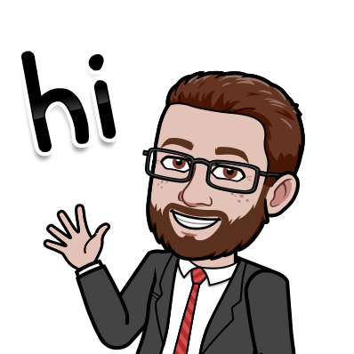
WELCOME TO CIVICS!
Mr. Paul Burkart
pburkart@evergladesprep.com
3rd year at EPA
Room 135

Slide 2

ATTENDANCE
Whenever you enter or leave a virtual classroom, please type your name in the video meeting chat.
This will be used as proof of attendance for the entire class.

Slide 3
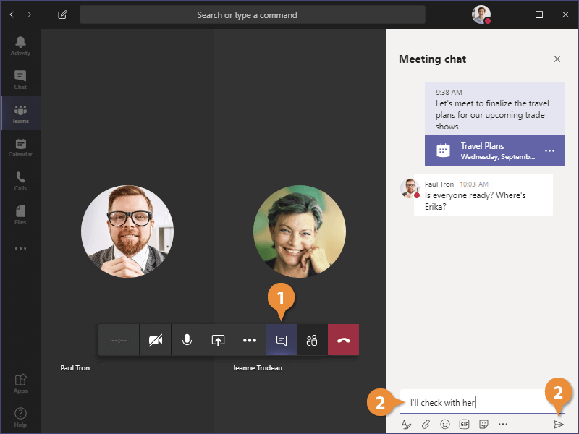
ATTENDANCE

Slide 4

SCHEDULE

Slide 5
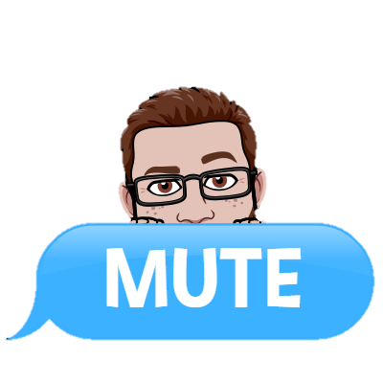
EXPECTATIONS FOR TEAMS
Join:
Join the meeting on time. When you enter the meeting, make sure you are in a quiet place without distractions (TV, pets, etc.). Please turn your camera on!
Mute:
As soon as you enter the meeting, please mute your microphone. If you are called on to answer a question, you may unmute yourself. Hit the mute button again when you are finished.
Come Prepared:
Come to the meeting prepared with questions you have about assignments or technology. You will also need to have your notebook/pencil handy.
Questions:
If you have a question/comment during the meeting, please click the “raise your hand” button OR type your question/comment in the “chat” and wait for me to call on you. When I call on you, you can unmute yourself and state your question/comment.

Slide 6


EXPECTATIONS FOR TEAMS
DO:
Dress appropriately
Join on time
Mute yourself immediately
Pay attention
Keep you video on
Keep the “chat” open
Refrain from chewing gum or eating food during meetings
Hang up at the end of class
DON’T:
Have distractions nearby
Enter the chat disrespectfully
Leave the chat unannounced
Share your screen unless directed to by the teacher
Unmute yourself unless you are told
Stay on the TEAMS meeting after class has ended

Slide 7
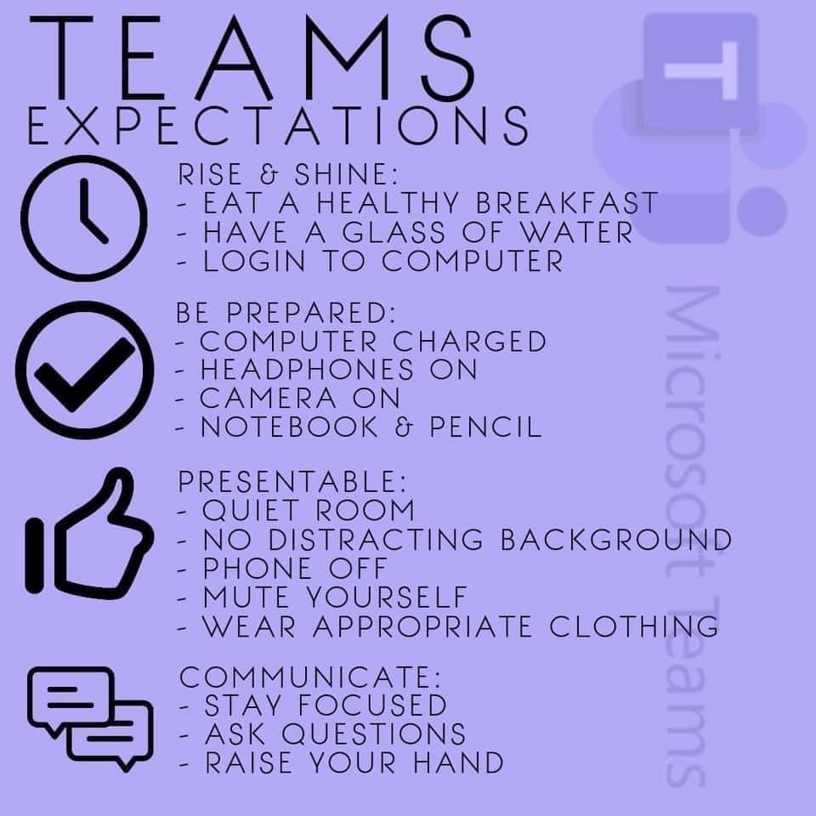

Slide 8
What does P.A.R.R. mean?
Participation
Students are expected to participate in all classroom activities and assignments while putting forth their best effort.
Full participation is expected by the teacher but its rewards are two fold:
Students will experience the rewards of working to their full potential.
Participation will enhance the learning environment, creating a cohesive community of learners.

Slide 9
What does P.A.R.R. mean?
Attitude
Attitude is everything!
Students should maintain a good attitude towards their teachers, classmates, school personnel and all aspects of the learning experience.
A positive attitude is an essential component of the student’s success and broadens their potential in the learning environment.

Slide 10
What does P.A.R.R. mean?
Respect
All students are expected to show respect to their teachers, classmates and all school personnel while attending EPA.
Respect should also be displayed with all properties of EPA ; textbooks, materials, desks, chairs, walls, etc.

Slide 11
What does P.A.R.R. mean?
Responsibility
It is the responsibility of the students to complete all classroom and homework assignments while putting forth their best effort.
In addition, the student is responsible for adhering to all EPA and MDCPS rules including following the dress code.

Slide 12
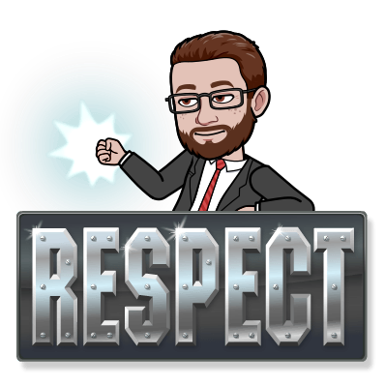
CLASSROOM RULES & PARR
Mr. B’s biggest rule: RESPECT!
What does RESPECT mean?
Do not talk when others are talking.
Raise your hand to speak (or type questions/comments in the chat).
Listen to each other.
Keep on task during class time.
No phones (unless allowed for education)
Nothing inappropriate in the chat
Follow directions

Slide 13
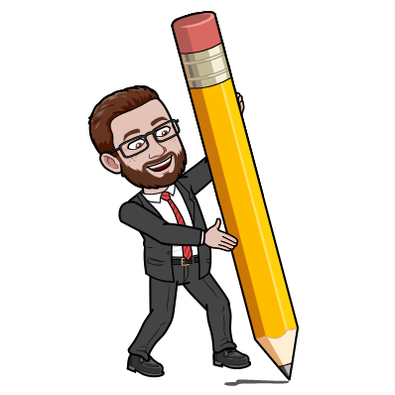
GRADING SCALE
CATEGORIES | WEIGHT
Classwork | 40%
Quizzes | 20%
Tests | 25%
Projects | 15%

Slide 14
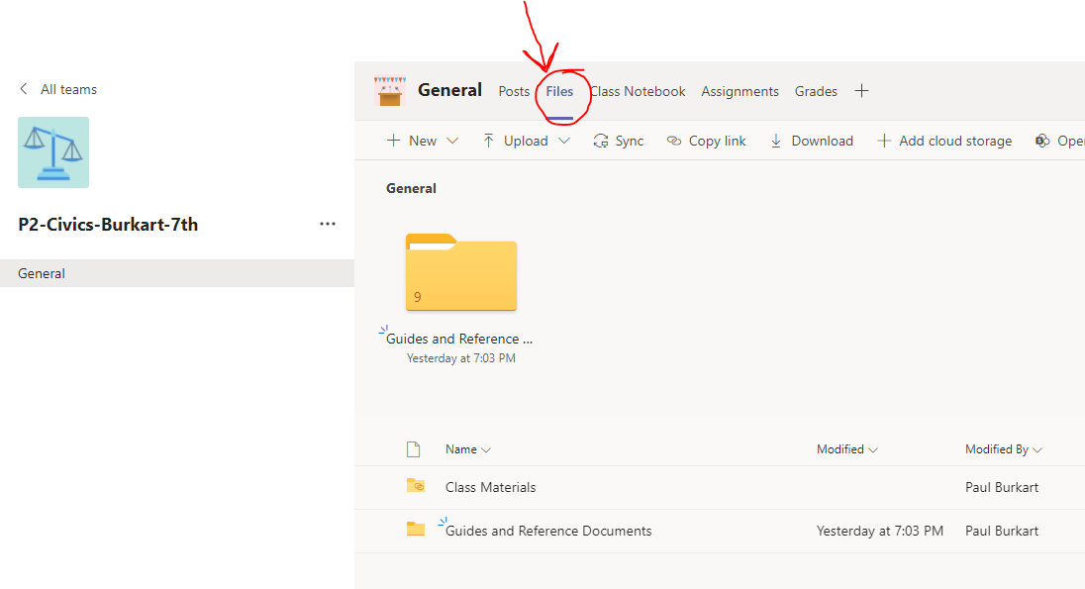
FILES on TEAMS

Slide 15
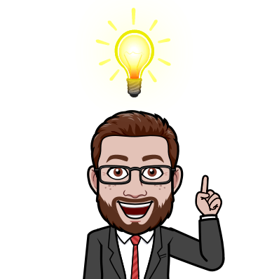
REMIND
Remind is an app used to send you reminders about tests, quizzes, and homework.
Signing up for the class on Remind is REQUIRED! (This is your first grade!)
Go to: rmd.at/epacivics1
OR text @epacivics1 to 81010

